Slide 1
Method of Estimation

Slide 2
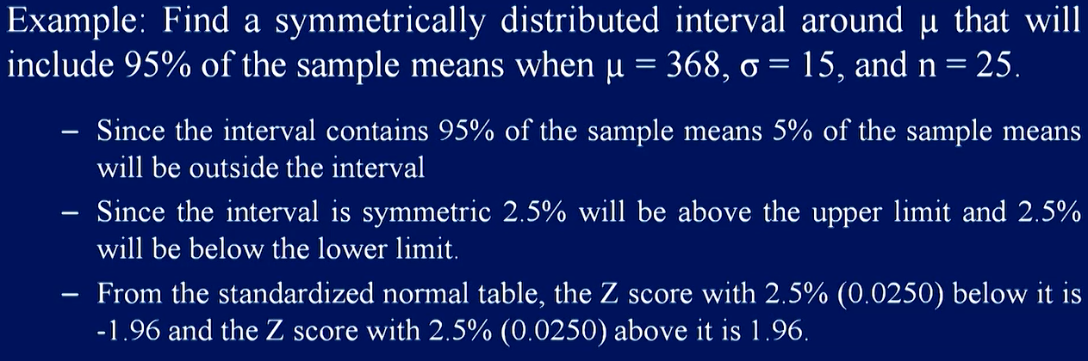
Determining an Interval including A Fixed Proportion of the Sample Mean

Slide 3
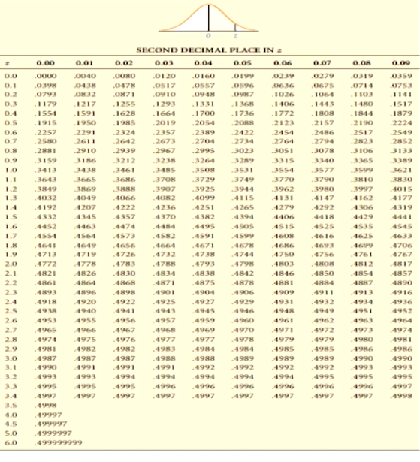

Slide 4
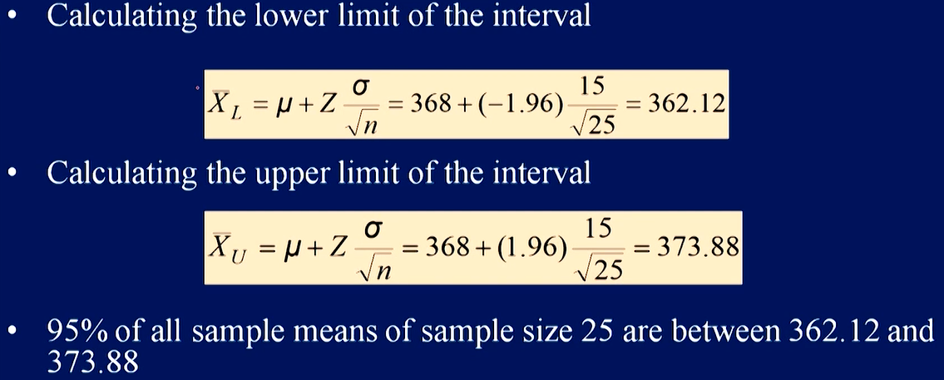
Cont’d…

Slide 5
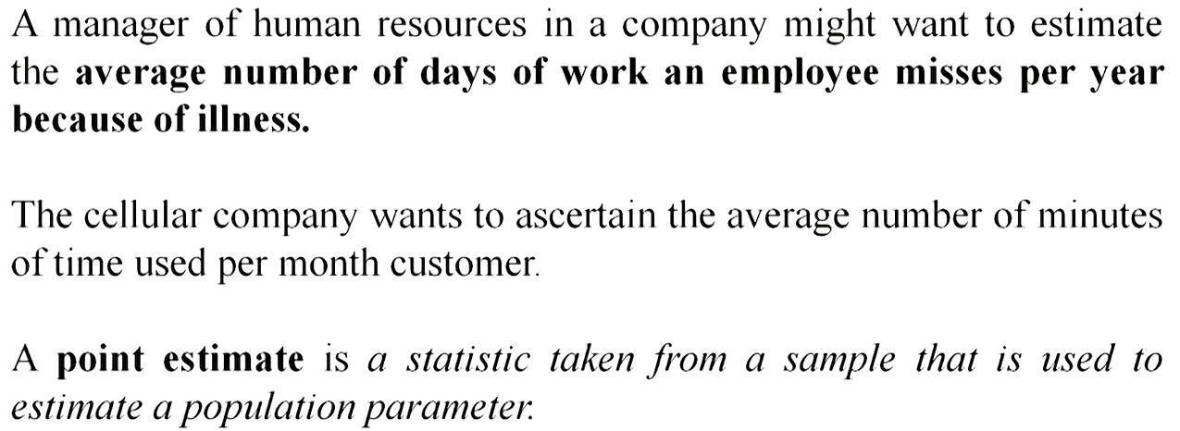
Confidence Interval Estimation

Slide 6
Point Estimate
A point estimate gives statisticians a single value as the estimate of a given population parameter. For example, the sample mean X̄ is the point estimate of the population mean μ. Similarly, the sample proportion p is a point estimate of the population proportion p when binomial modeling is involved.
it has no sampling distribution.
Point estimates are subject to bias, where the bias is the difference between the expected value of the estimator and the true value of the population parameter involved.

Slide 7
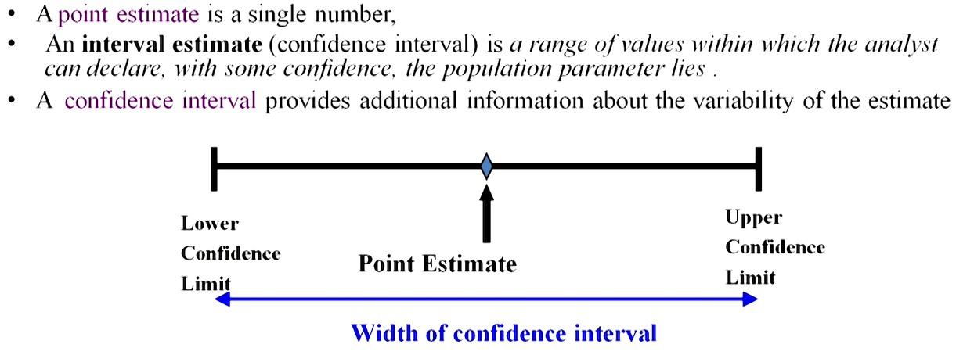
Point and Interval Estimate

Slide 8
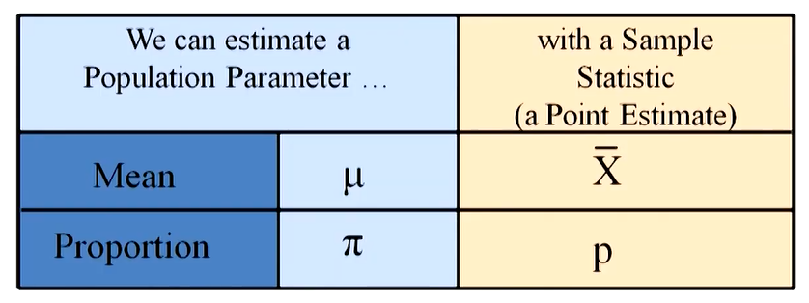
Point Estimates

Slide 9
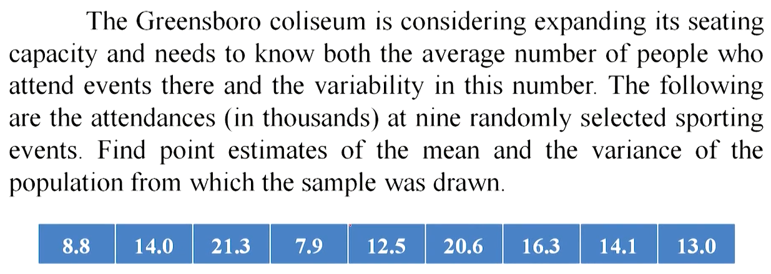
Example #1

Slide 10
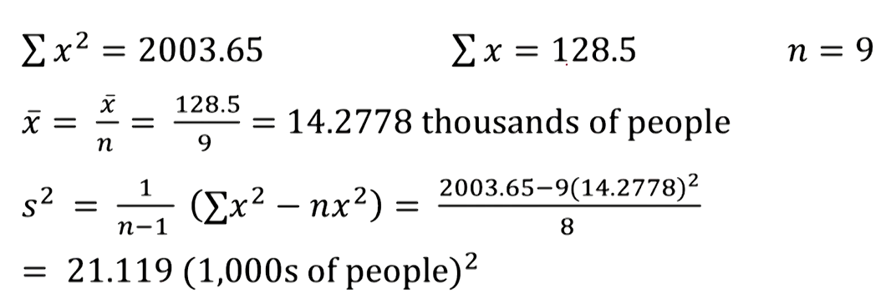
Solution #1

Slide 11
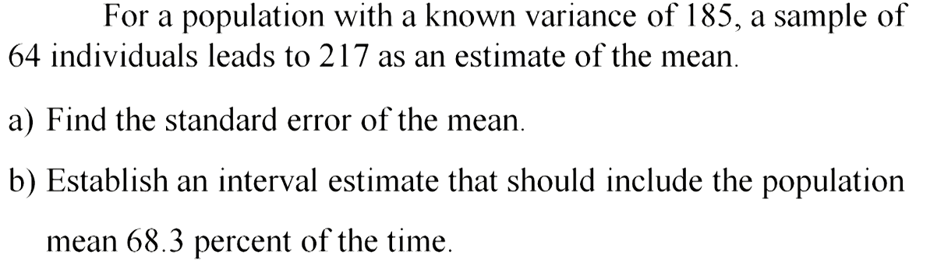
Example #2

Slide 13
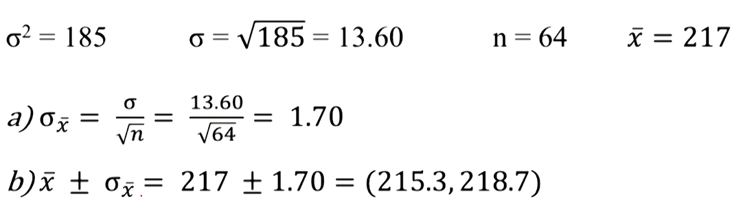
Solution #2

Slide 14
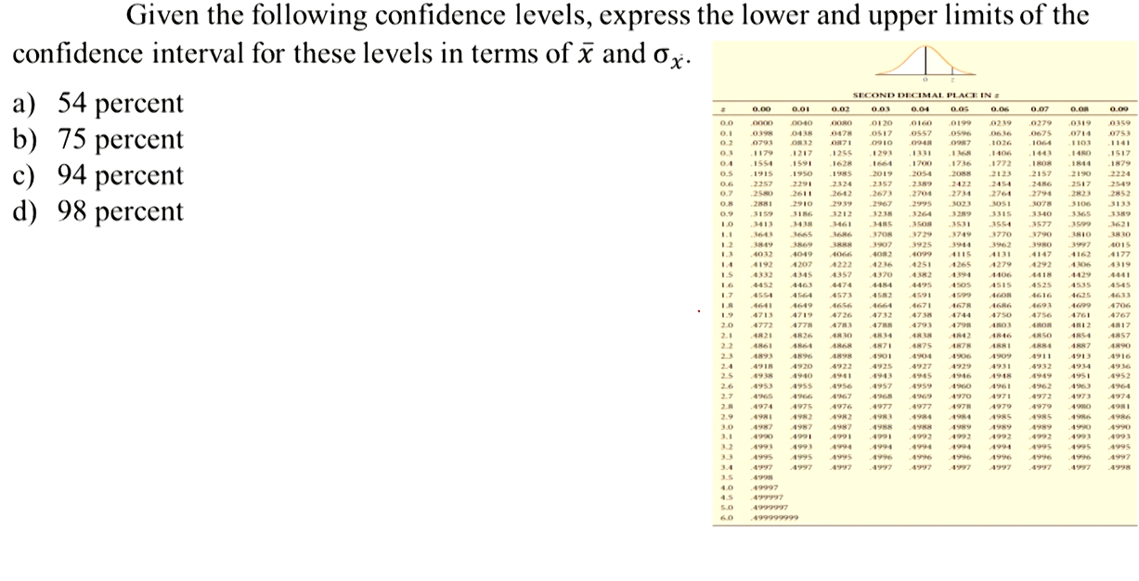
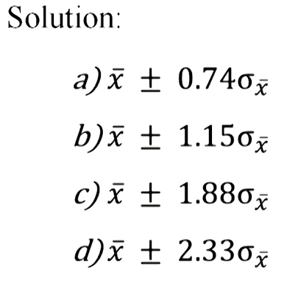
Example #3

Slide 15
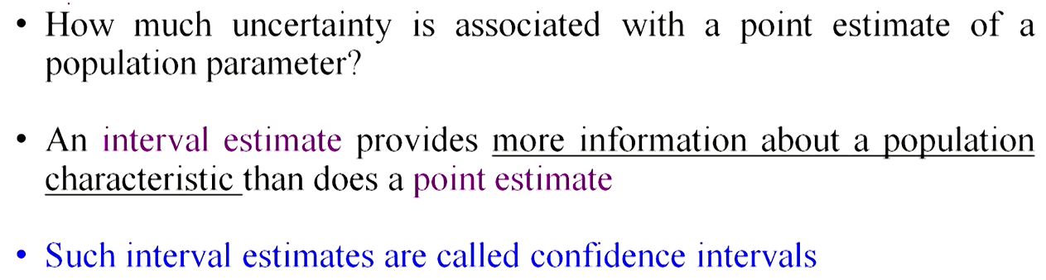
Confidence Intervals

Slide 16
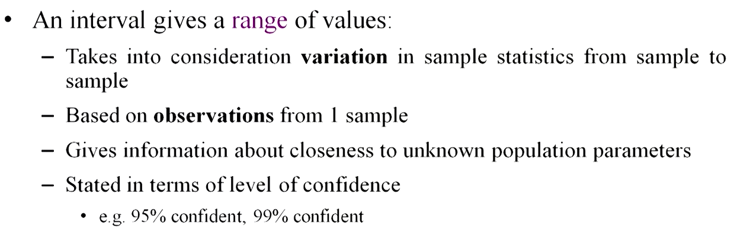
Confidence Interval Estimates

Slide 17
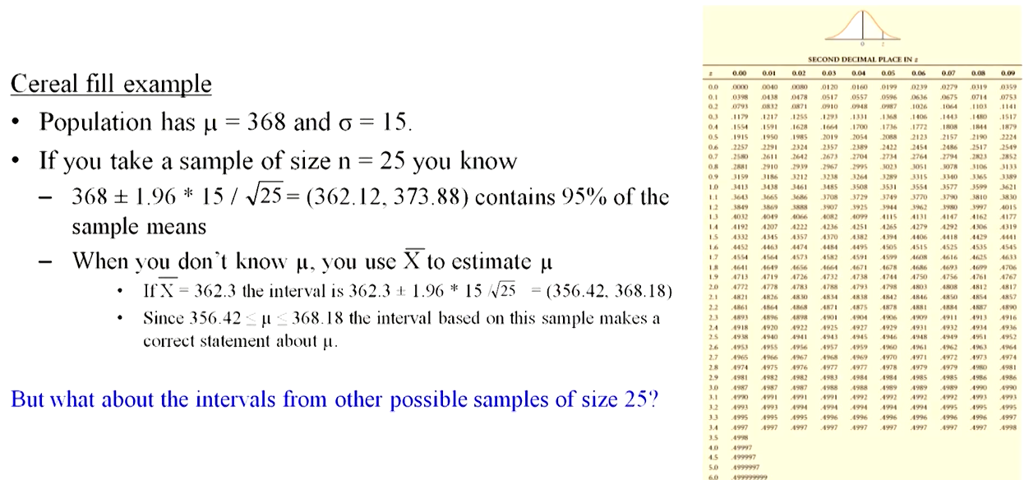
Example

Slide 18
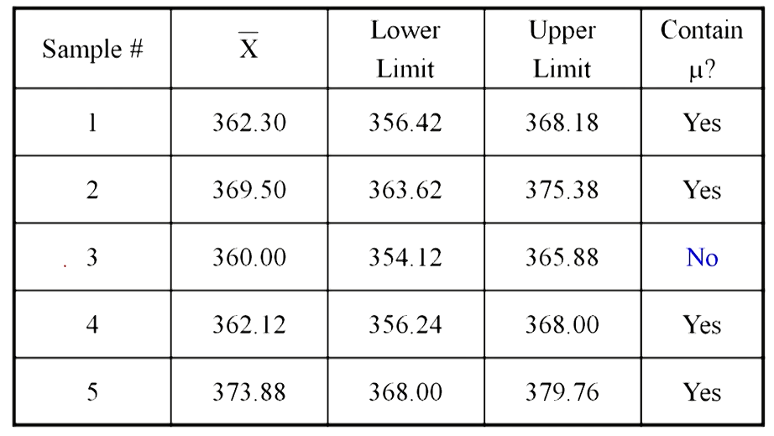
Cont’d…

Slide 19
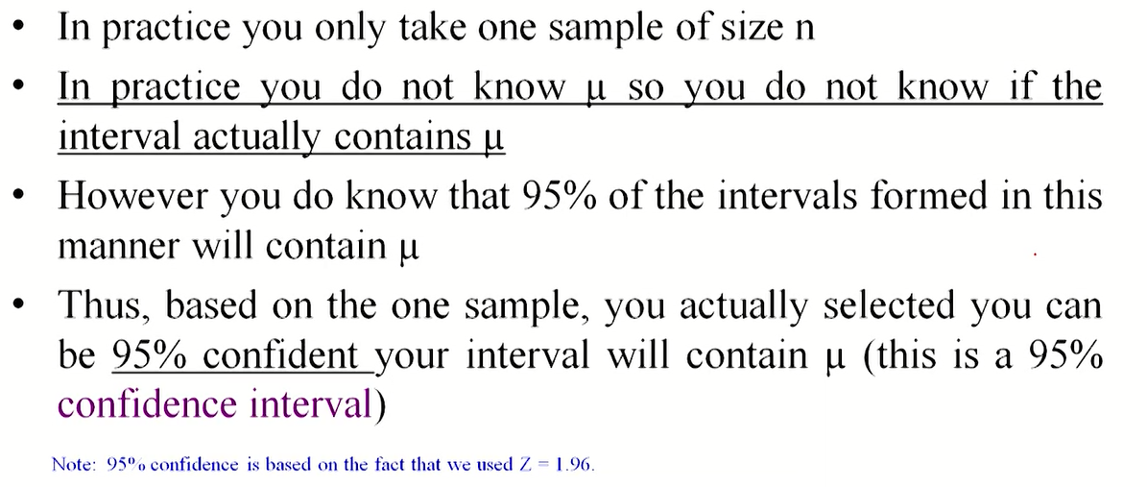
Cont’d…

Slide 20
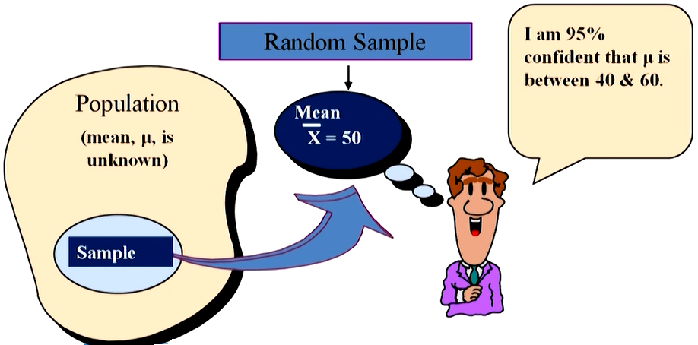
Estimation Process

Slide 21
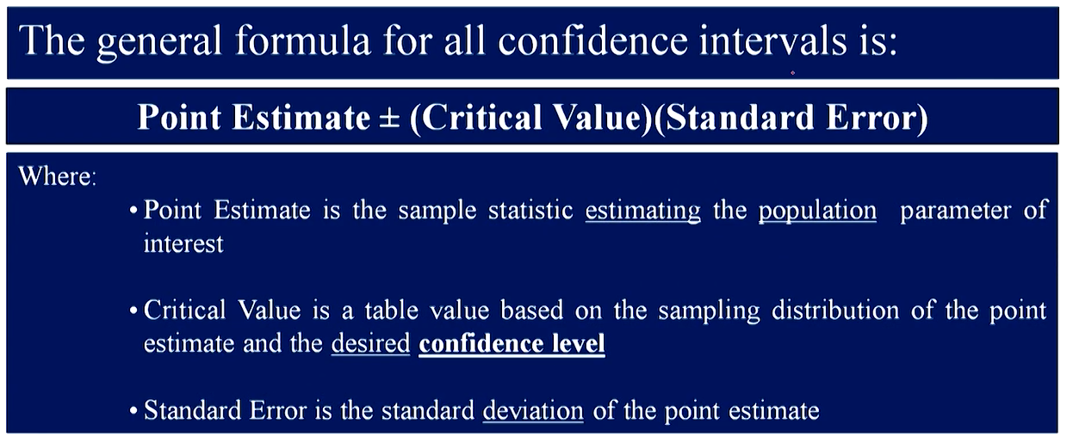
General Formula

Slide 22
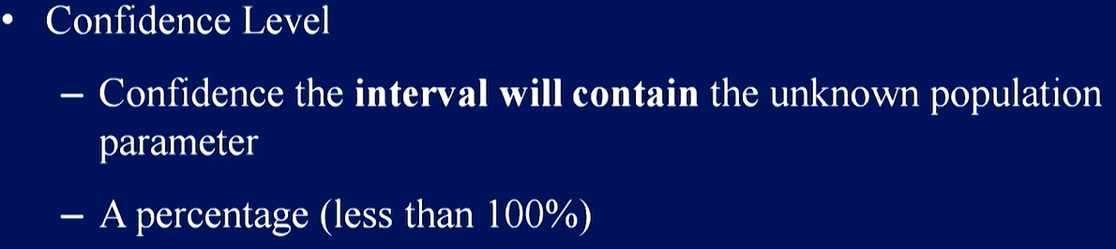
Confidence Level

Slide 23
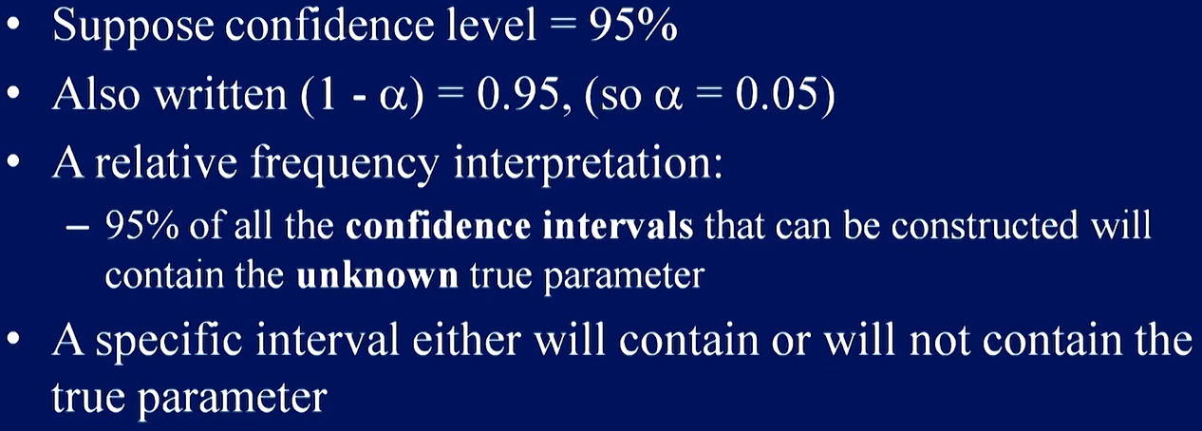
Confidence Level, (1-α)

Slide 24
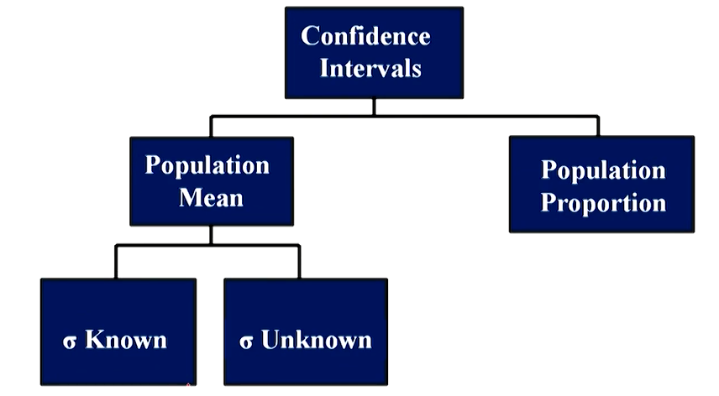
Confidence Intervals

Slide 25
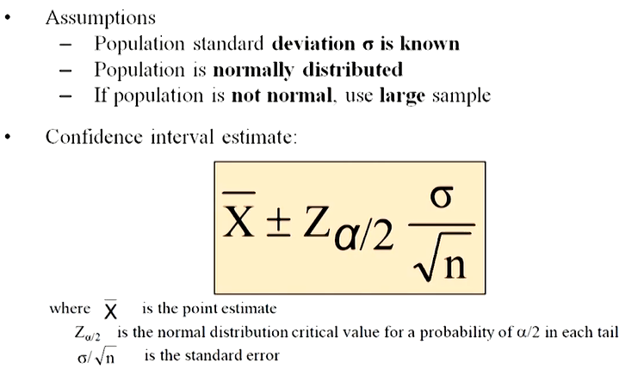
Confidence Interval for μ (σ known)

Slide 26
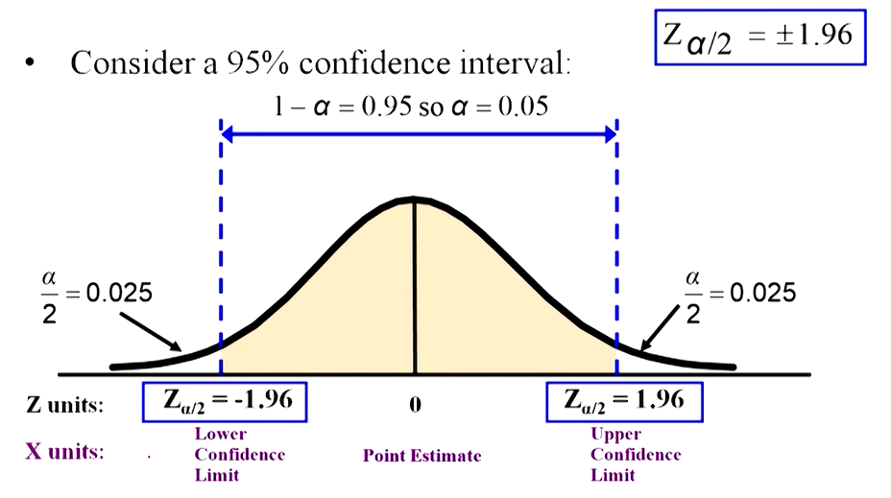

Slide 27
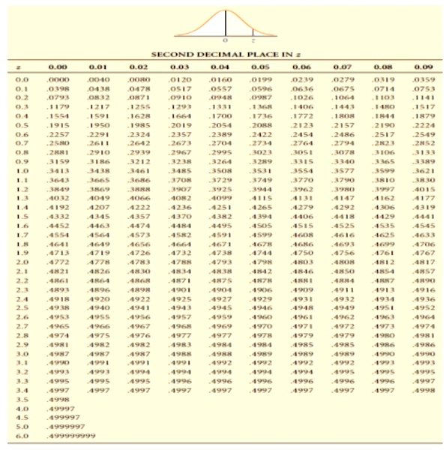
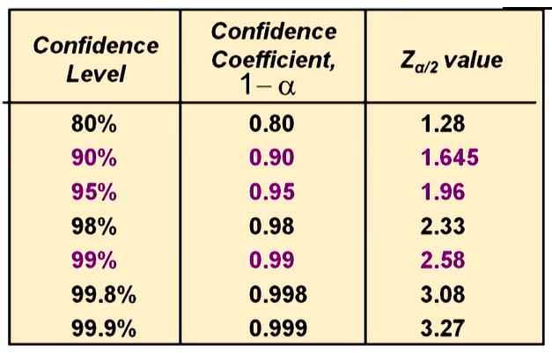

Slide 28
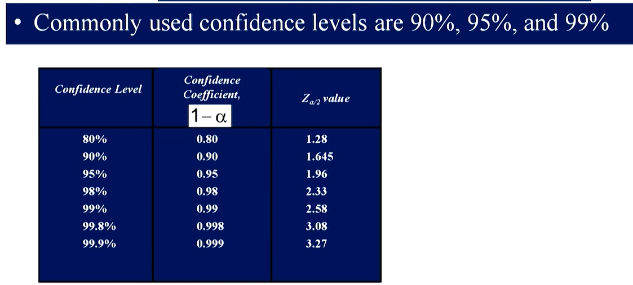
Common Level of Confidence

Slide 29
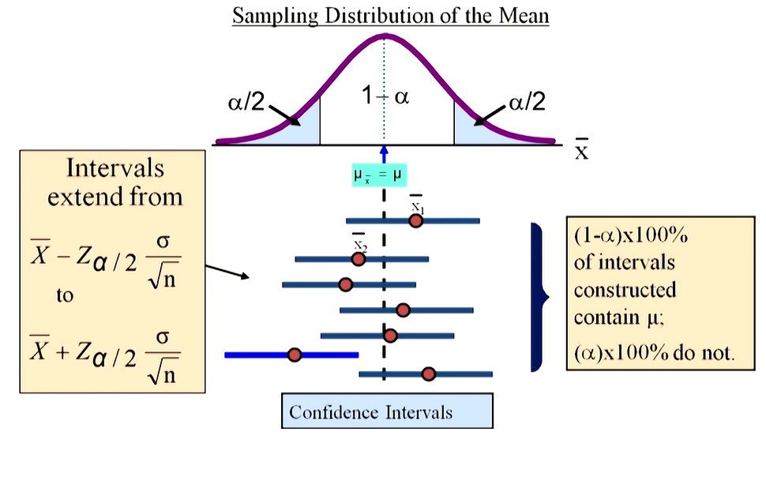
Intervals and Level of Confidence

Slide 30
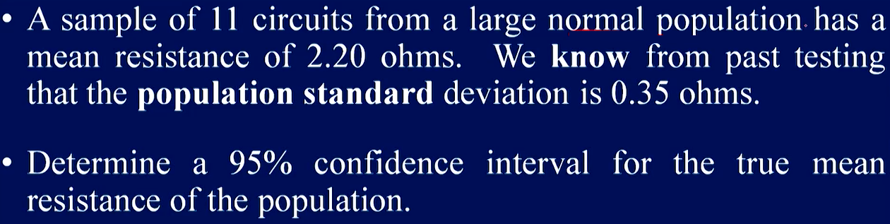
Example

Slide 31
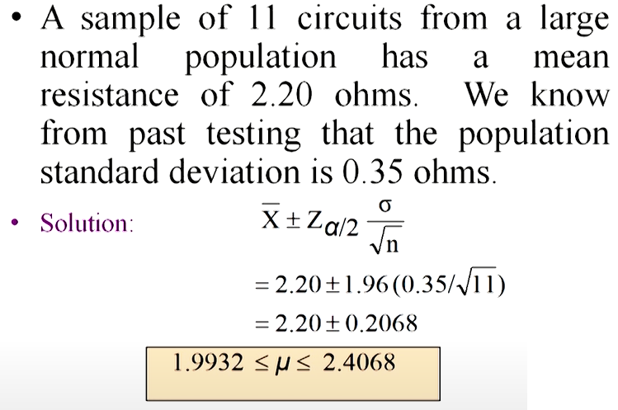
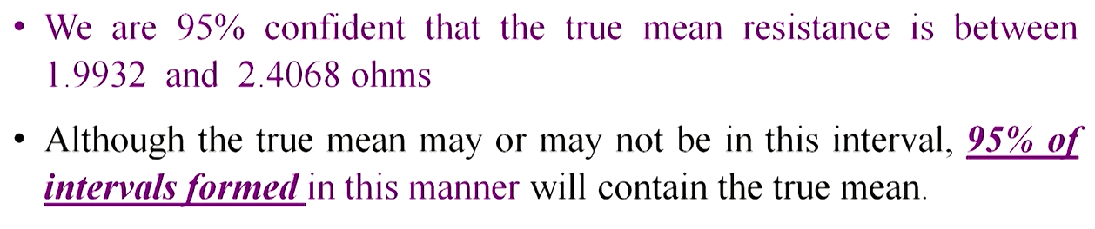

Slide 32
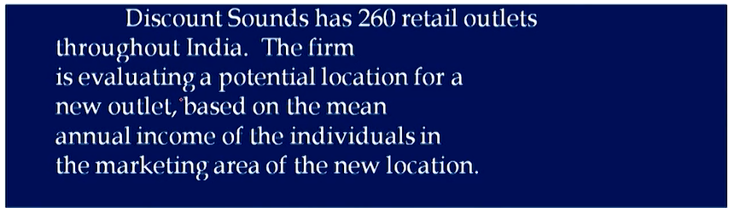
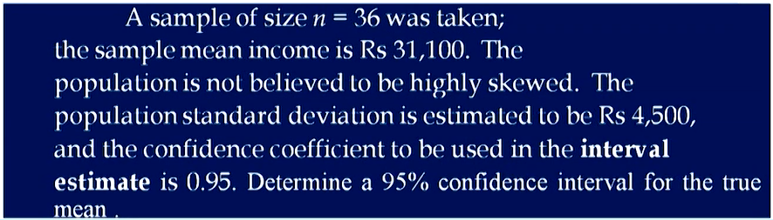
Example

Slide 33
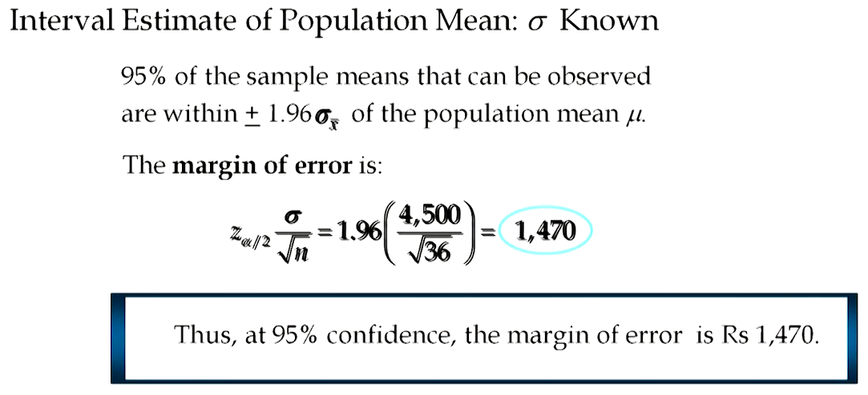
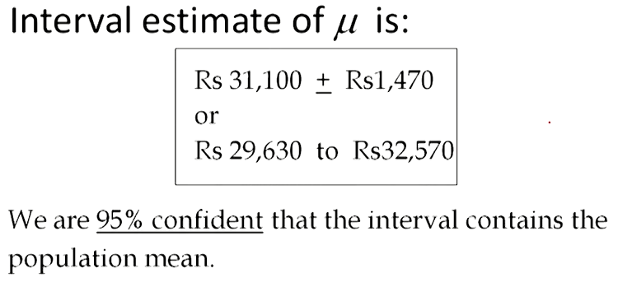
Solution

Slide 34
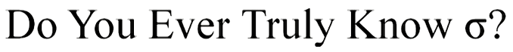
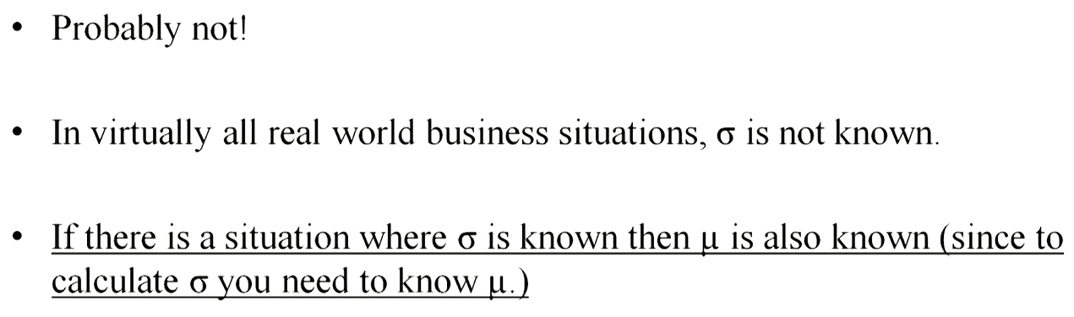

Slide 35
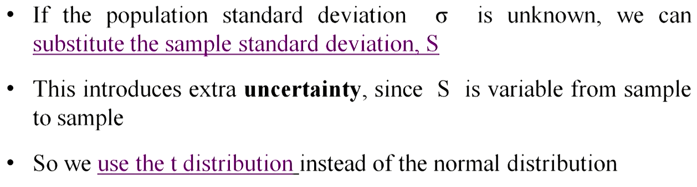
Confidence Interval for μ (σ unknown)

Slide 36
Student’s t-distribution
The T distribution, also known as the Student’s t-distribution, is a type of probability distribution that is similar to the normal distribution with its bell shape but has heavier tails. T distributions have a greater chance for extreme values than normal distributions, hence the fatter tails.
Tail heaviness is determined by a parameter of the T distribution called degrees of freedom, with smaller values giving heavier tails, and with higher values making the T distribution resemble a standard normal distribution with a mean of 0, and a standard deviation of 1.

Slide 37
Cont’d…
When a sample of n observations is taken from a normally distributed population having mean M and standard deviation D, the sample mean, m, and the sample standard deviation, d, will differ from M and D because of the randomness of the sample.
A z-score can be calculated with the population standard deviation as Z = (x – M)/D, and this value has the normal distribution with mean 0 and standard deviation 1. But when using the estimated standard deviation, a t-score is calculated as T = (m – M)/{d/sqrt(n)}, the difference between d and D makes the distribution a T distribution with (n - 1) degrees of freedom rather than the normal distribution with mean 0 and standard deviation 1.

Slide 38
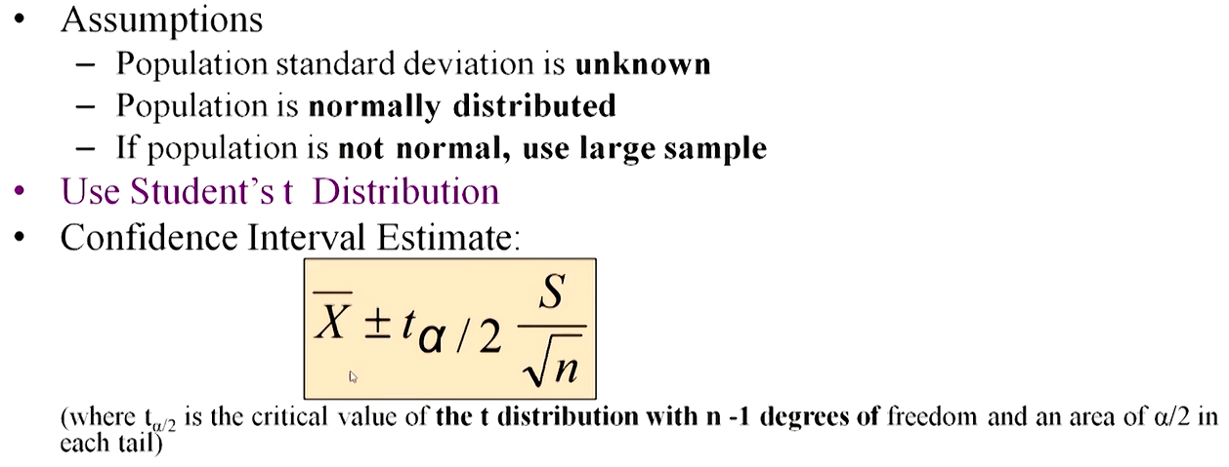
Cont’d…

Slide 39
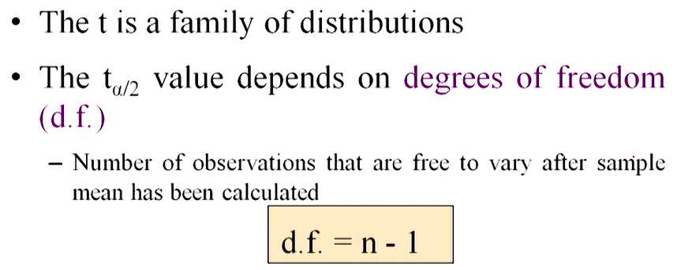
Student’s t Distribution

Slide 40
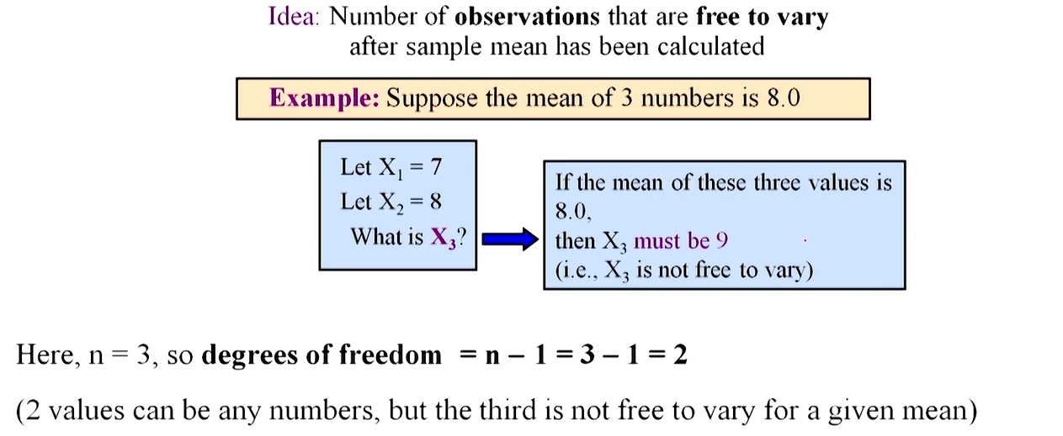
Degree of Freedom(df)

Slide 41
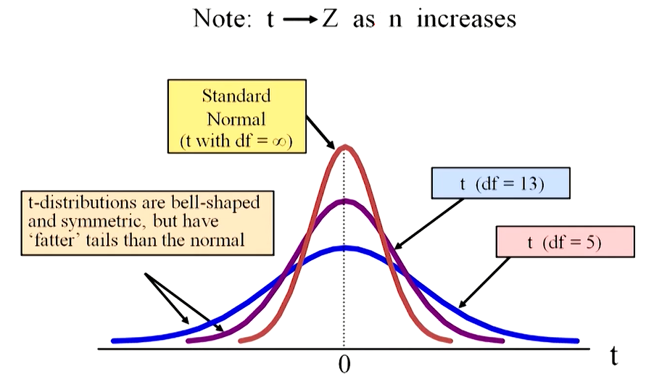
Student’s t Distribution

Slide 42
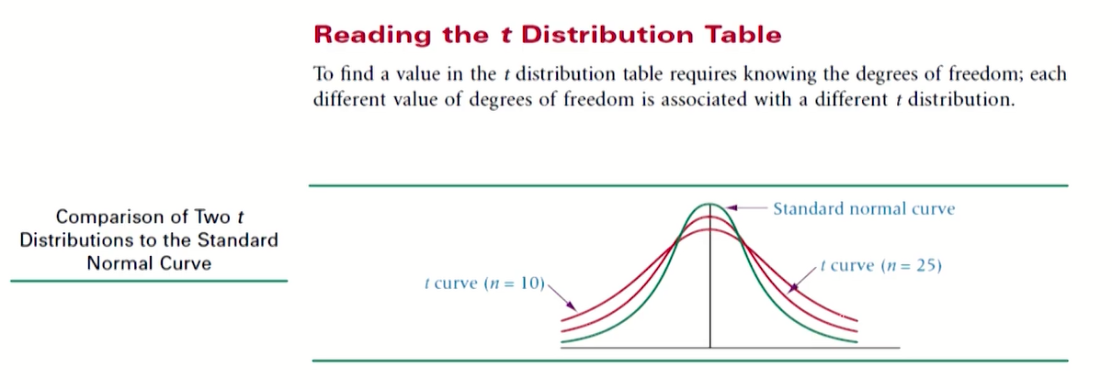
Student’s t Table

Slide 43
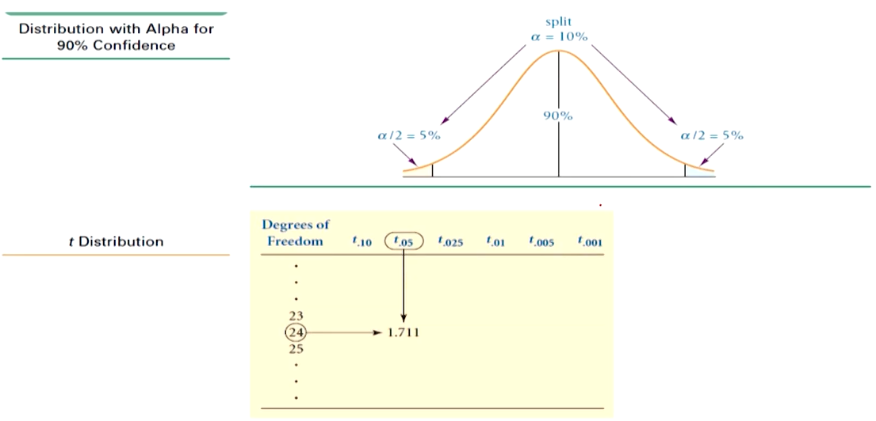
Cont’d…

Slide 44
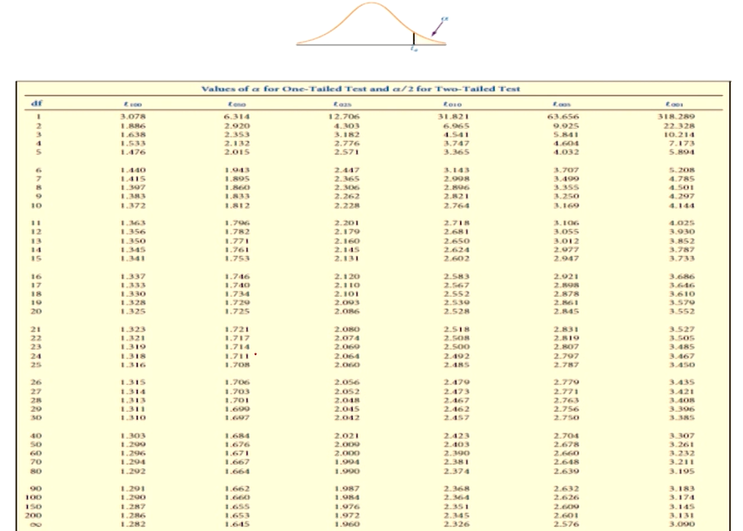
Student’s t Table

Slide 45
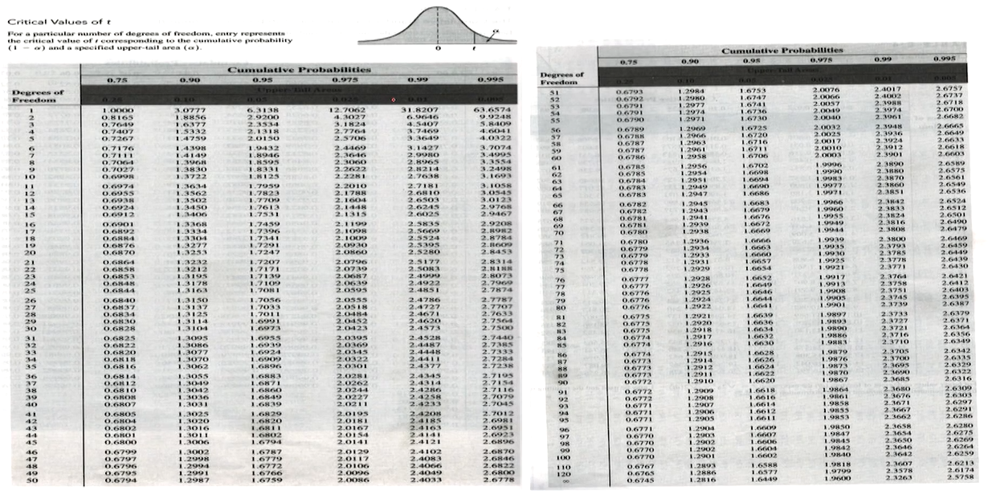
Cont’d…

Slide 46
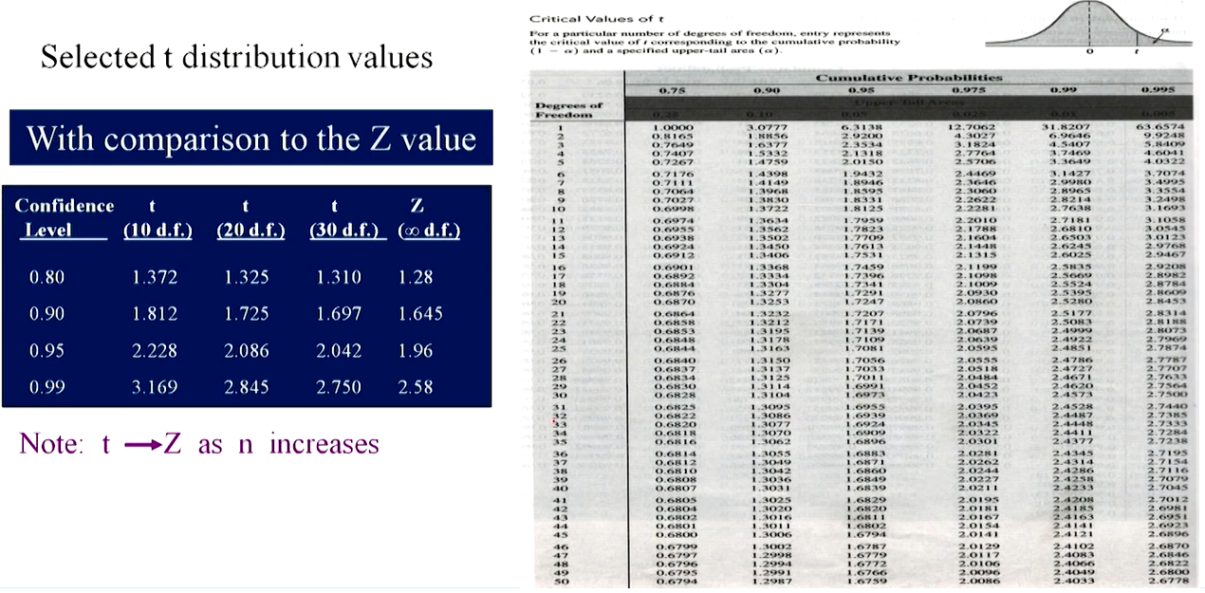

Slide 47
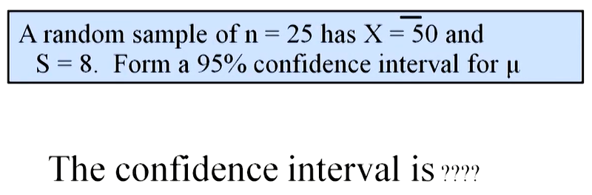
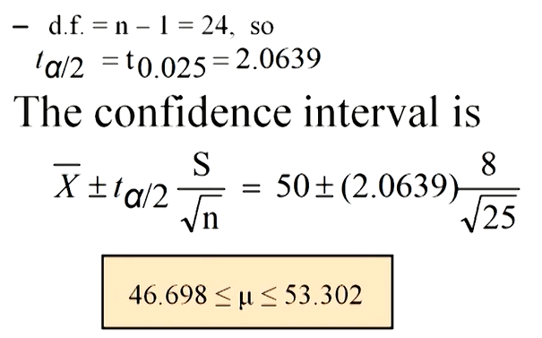
Example

Slide 48
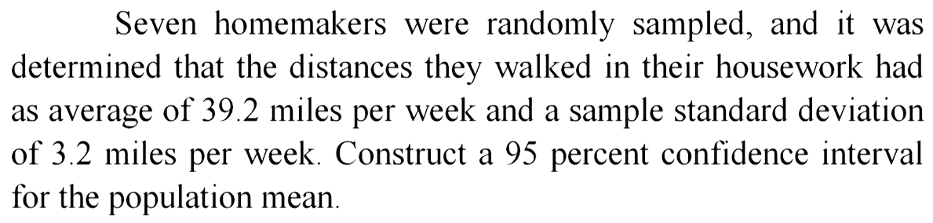

Example

Slide 49




Slide 50

Confidence Interval Endpoints

Slide 51



Example

Slide 52


Example

Slide 53


Example

Slide 54


Solution

Slide 55

Sample size for an Interval Estimation of a Population Proportion

Slide 56


Example

Slide 57

Determine Sample Size

Slide 58


Sampling Error

Slide 59

Cont’d…

Slide 60

Cont’d…

Slide 61


Example

Slide 62

If σ is unknown

